Slide 1
Yearly MARKETING plan
by Malgorzata Popielska

Slide 2


CONTENT
ACTIVITIES 2025-2026: UP-DATE
ACTIVITIES PLAN FOR 2026-2027
NEW MATERIALS & TOOLS
3

Slide 3
2025-2026: Up-date
1
Ongoing projects and upcoming campaigns:
Limited edition 2026
Vegan brochure for FS
Announcement: TVC 2027

Slide 4
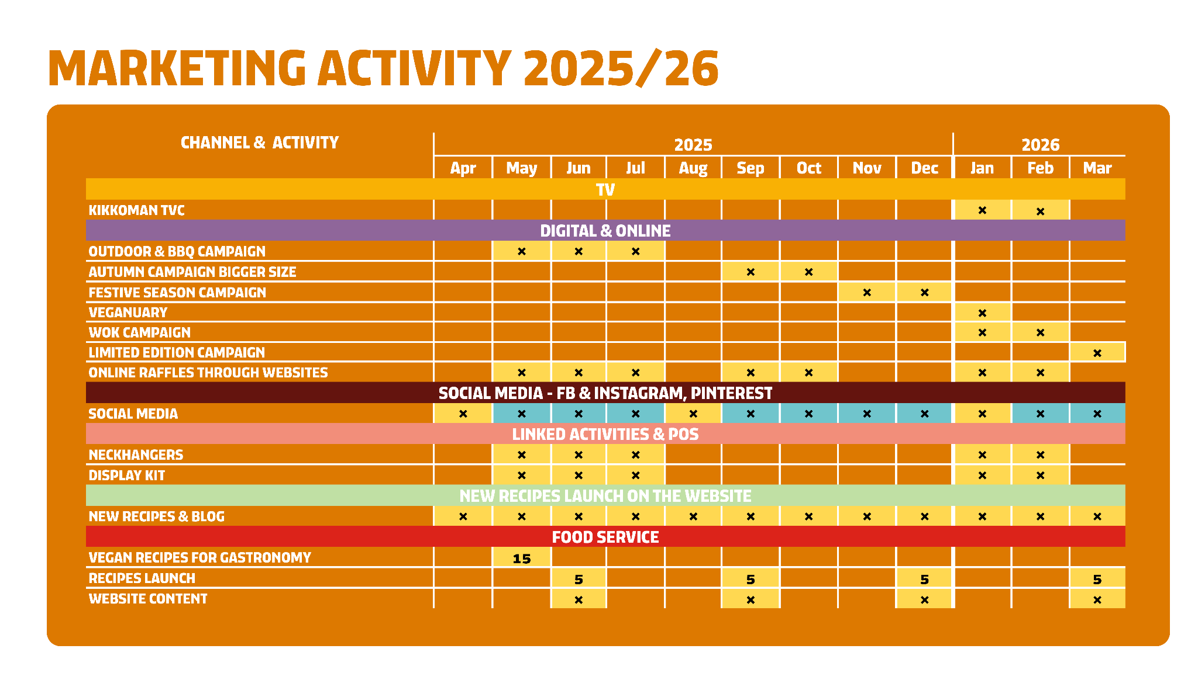

Slide 5
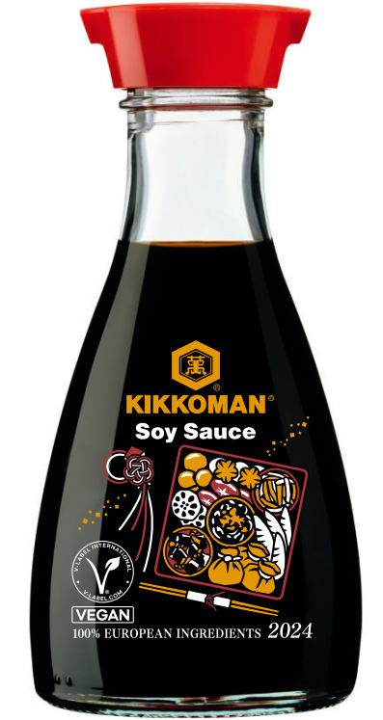
Limited edition CAMPAIGN 2026
GOAL
To stay top of mind of our users & gain attention of new users
CHANGE OF TIMING TO MARCH 2026
FOCUS
Unique limited edition bottle & story
MATERIAL
New video promoting the story of this particular motif
START
March 2026
DURATION
4 weeks
?
BUDGET
To be confirmed later
TARGET MARKETS: countries which will sell limited edition

Slide 6
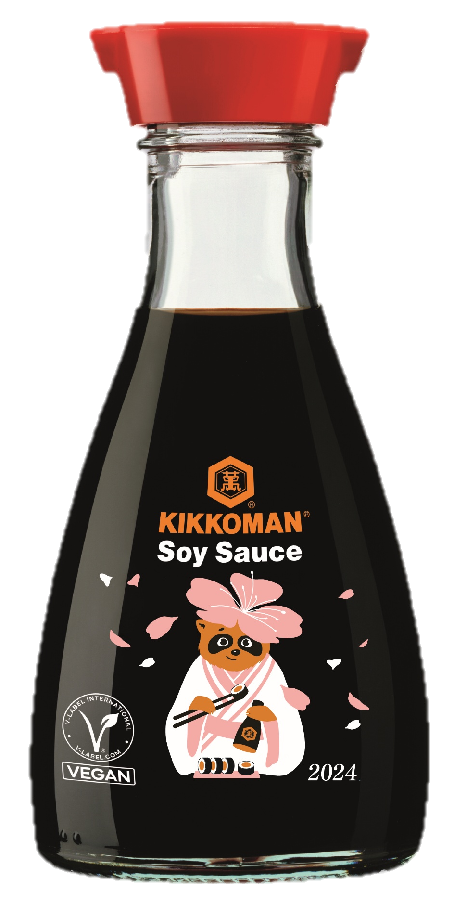
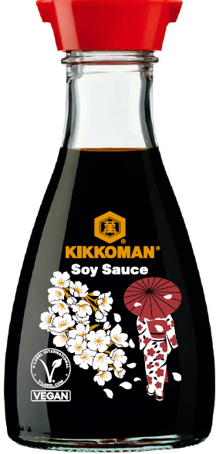
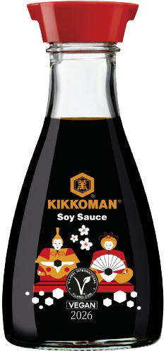
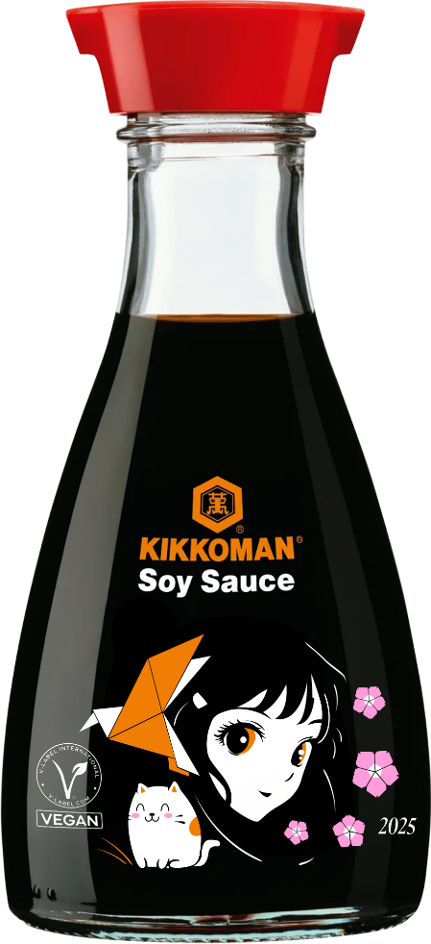
Limited edition – motif for 2026
CHERRY BLOSSOMS AND LADY IN KIMONO
HINA NINGYO
MANGA & CO
TANUKI
HELP US CHOOSE THE BEST MOTIF!

Slide 7
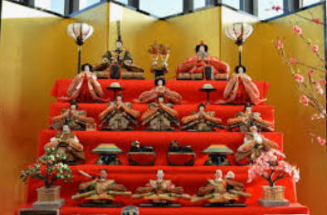

Limited edition – motifS selection for 2026
HINA MATUSURI on 3rd of March
Origins as purification ritual and prayer for good luck and health (paper dolls)
Today as Girls Day: celebration of girls well-being and feminity
Display of Hina dolls representing imperial court of Heian period
HINA NINGYO

Slide 8
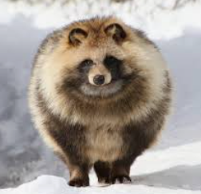
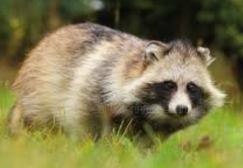

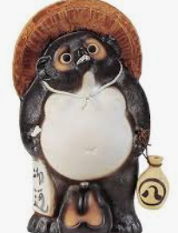

Limited edition – motifS selection for 2026
TANUKI: RACCOON DOG
Mythical figure of Japanese folklore
Playful, shape-shifting, magical abilities, love for jokes & mischief
Symbol for good fortune, prosperity and joyful approach to life
TANUKI

Slide 9
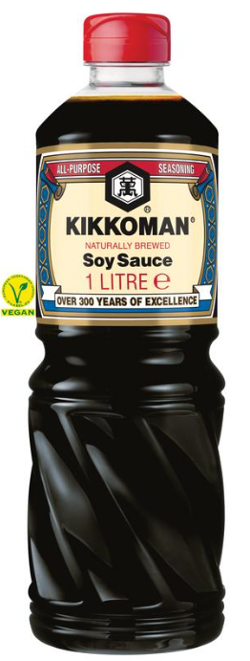



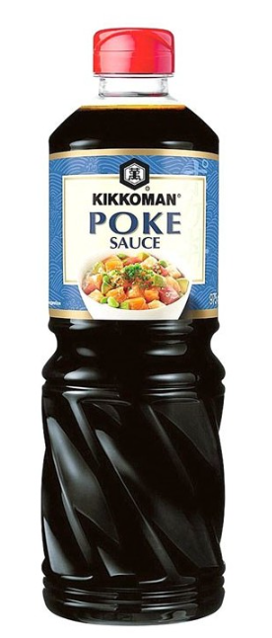
Food service: VEGAN INSPIRATION
15 INTERNATIONAL VEGAN RECIPES
LAUNCH OF RECIPES: MAY 2025
brochure in English
available on the website,
recipes available in canto
LAUNCH OF BROCHURE: MAY 2025
PRODUCTS PROMOTED IN THE RECIPES:

Slide 10

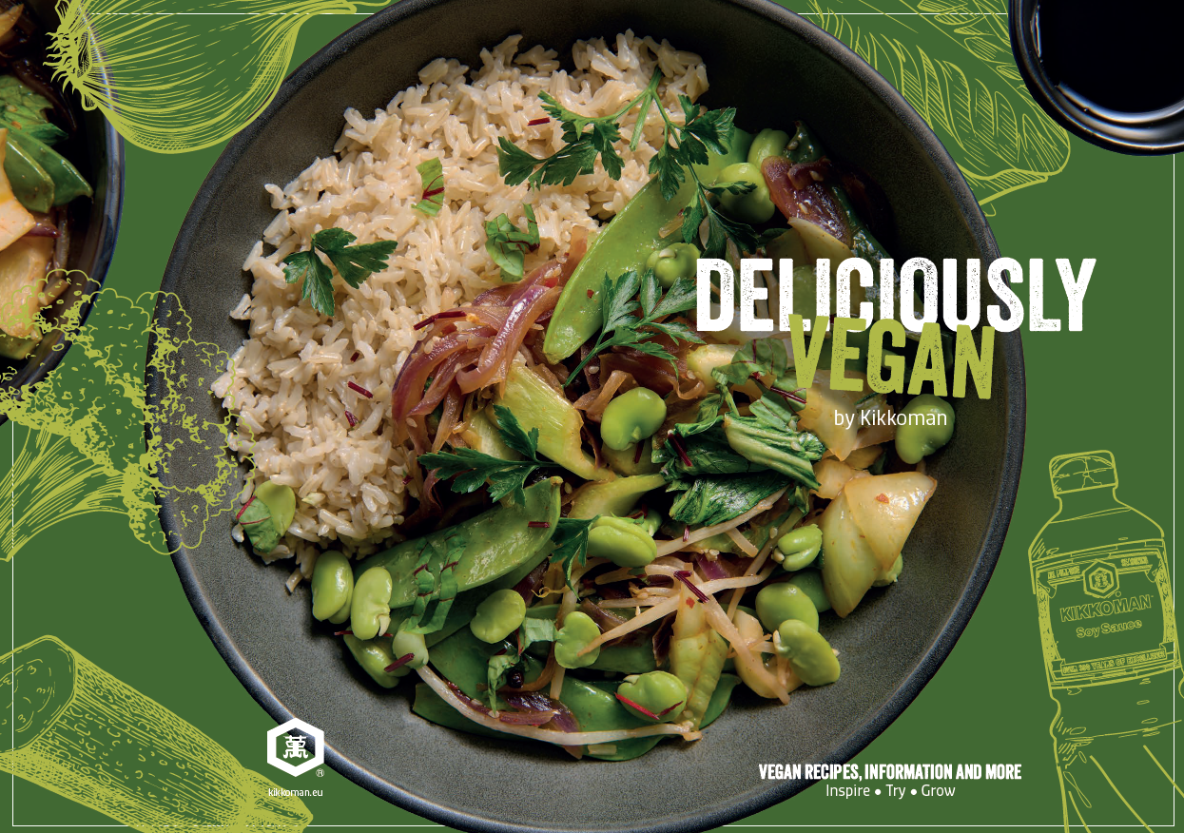
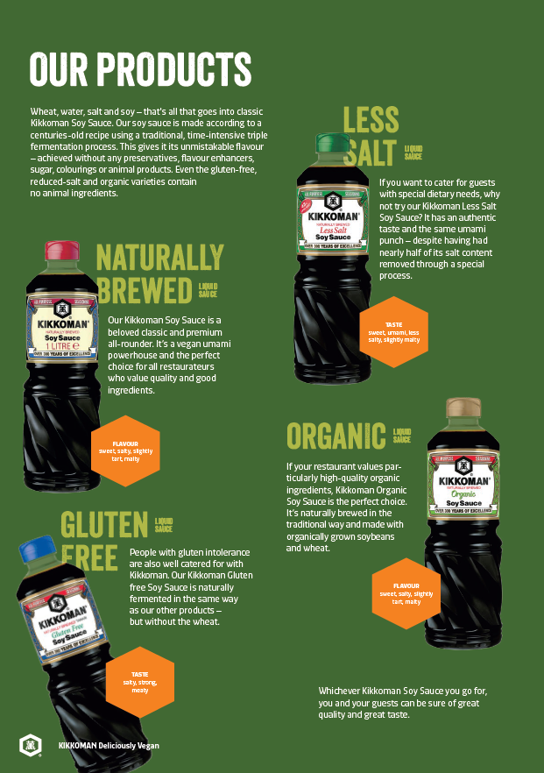
Food service: VEGAN INSPIRATION

Slide 11

TVC CAMPAIGN 2027 – united in project
JOIN US IN THE CREATION OF NEW KIKKOMAN TVC!
SHOOTING: between 19th and 23rd of July 2025
PLACE: Portugal

Slide 12
PLAN FOR 2026-2027
2
Yearly marketing activities plan for next fiscal year
2a: Retail
2b: Food Service

Slide 13
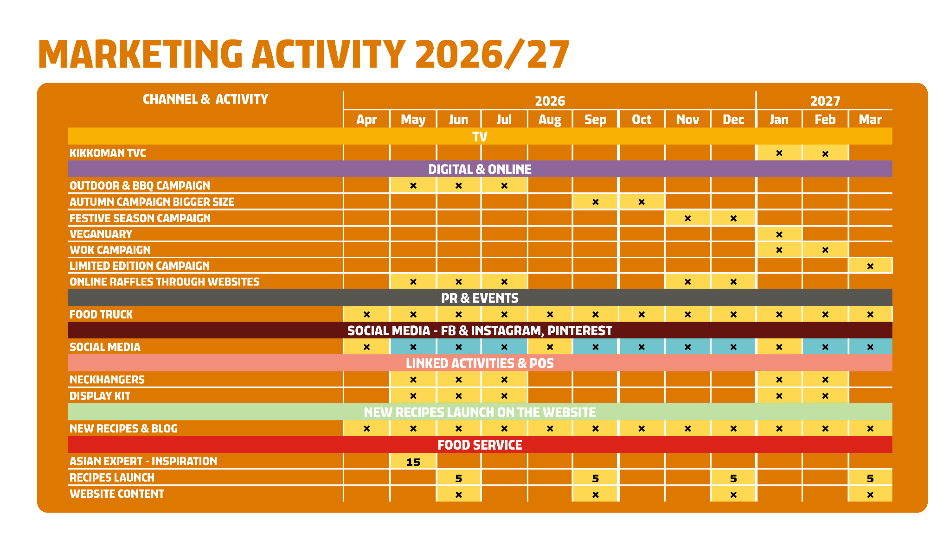

Slide 14
RETAIL
2a
Central marketing activities targeting consumers

Slide 15

Outdoor & BBQ CAMPAIGN 2026
GOAL
To promote Kikkoman products as perfect ingredients for BBQ and any other food enjoyed outdoors, to stay top of mind in summer season
FOCUS
Inspiration for variety of products: soy sauces, Teriyaki, Ponzu, Poke, Kimchi
MATERIAL
Outdoor video promoting food & outdoor lifestyle, Outdoor KV, new recipes
START
May-June 2026
DURATION
4-6 weeks
BUDGET
tbc
COUNTRIES INCLUDED: UK, Germany, France, Spain, Italy, Netherlands, Norway, Sweden, Poland, Austria, Switzerland, Finland, Denmark, Belgium, Portugal, Czech, Latvia, Bulgaria

Slide 16
Outdoor & BBQ - CAMPAIGN package 2026
POS:
NECKHANGERS
DISPLAYS
LANDING
PAGE
OUTDOOR RECIPES
VIDEO SPOT: YOUTUBE
META
RAFFLE
WITH
PRIZES
MEDIA
BUDGET
TBC
ADS:
META
GOOGLE

Slide 17


Bigger size CAMPAIGN 2026
GOAL
To promote bigger sizes of soy sauce, make it recognizable and boost autumn sales
FOCUS
Soy sauce and Less Salt: same product, brand, quality and taste in bigger bottle
MATERIAL
Current video & KV, recipes for meal preps
START
September 2026
DURATION
4-6 weeks
BUDGET
tbc
COUNTRIES INCLUDED: UK, Germany, France, Spain, Italy, Netherlands, Norway, Poland, Austria, Switzerland, Finland, Denmark, Belgium, Portugal, Czech, Latvia, Bulgaria

Slide 18
Bigger size - CAMPAIGN package 2026
MEAL
PREPS RECIPES
VIDEO SPOT: YOUTUBE
META
MEDIA
BUDGET
TBC
LANDING
PAGE
ADS:
META
GOOGLE

Slide 19
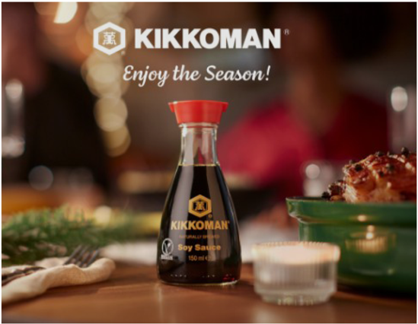
Winter season CAMPAIGN 2026
GOAL
To stay top of mind in time of festivities & boost sales in Xmas time
FOCUS
Soy sauce as all purpose seasoning, inspiration for festive menus
MATERIAL
Current video & KV, festive recipes (snacks)
START
November-December 2026
DURATION
4-6 weeks
BUDGET
tbc
COUNTRIES INCLUDED: UK, Germany, France, Spain, Italy, Netherlands, Norway, Sweden, Poland, Austria, Switzerland, Finland, Denmark, Belgium, Portugal, Czech, Latvia, Bulgaria

Slide 20
Winter season - CAMPAIGN package 2026
NEW
FESTIVE RECIPES
VIDEO SPOT: YOUTUBE
META
MEDIA
BUDGET
TBC
RAFFLE
WITH
PRIZES
LANDING
PAGE
ADS:
META
GOOGLE

Slide 21
TVC CAMPAIGN 2027
GOAL
To raise brand awareness & to invite consumers to use Kikkoman soy sauce & join Kikkoman community
FOCUS
Soy sauce as all purpose seasoning, the brand as a common denominator for different cultures and traditions
MATERIAL
NEW MATERIAL
To be presented in distributors meeting 2026
START
To be discussed individually, similar timing to current timing (Jan-Feb 2027)
DURATION
About 3-4 weeks
MEDIA BUDGET
Similar to current budget
MEDIA PLAN: proposals will be sent in Q2 2026 including linear / non-linear TVC & sponsorships
COUNTRIES INCLUDED: France, Spain, Italy, Netherlands, Norway, Sweden, Poland, Austria, Switzerland

Slide 22
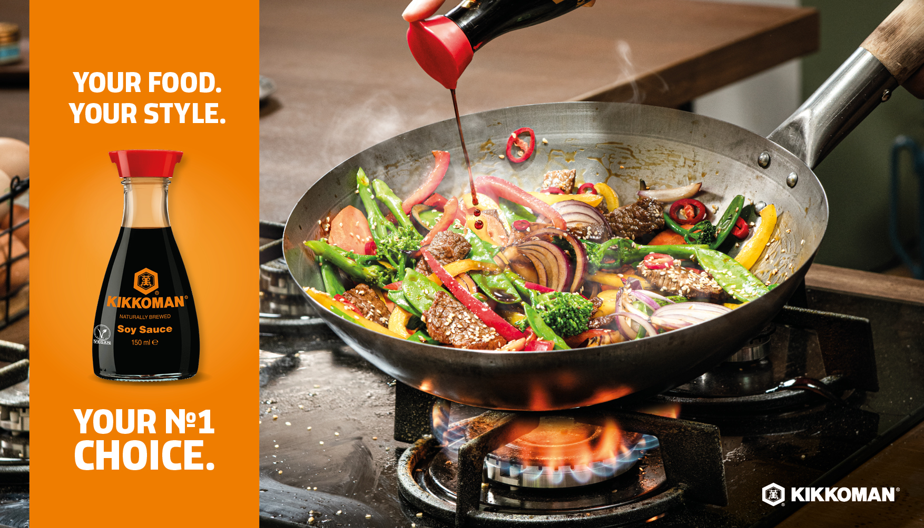
Wok CAMPAIGN 2027
GOAL
To differentiate Kikkoman soy sauce from cheap sauces and private labels within Asian category
FOCUS
Authentic taste in Asian dishes
MATERIAL
Current video & KV, WOK recipes
START
February 2027
DURATION
4-6 weeks
BUDGET
tbc
COUNTRIES INCLUDED: UK, Germany, France, Spain, Italy, Netherlands, Norway, Sweden, Poland, Austria, Switzerland, Finland, Denmark, Belgium, Portugal, Czech, Latvia, Bulgaria

Slide 23
WOK - CAMPAIGN package 2027
WOK RECIPES
VIDEO SPOT: YOUTUBE
META
MEDIA
BUDGET
TBC
LANDING
PAGE
ADS:
META
GOOGLE

Slide 24
Limited edition CAMPAIGN 2027
GOAL
To stay top of mind of our users & gain attention of new users
FOCUS
Unique limited edition bottle & story
MATERIAL
New video promoting the story of this particular motif
START
March 2027
?
DURATION
4 weeks
BUDGET
To be confirmed later
COUNTRIES INCLUDED
UK, Germany, France, Spain, Italy, Netherlands, Norway, Sweden, Poland, Austria, Switzerland, Finland, Denmark

Slide 25
Limited edition - CAMPAIGN package 2027
ADS:
META
GOOGLE
LANDING
PAGE
VIDEO SPOT: YOUTUBE
META
MEDIA
BUDGET
TBC

Slide 26
yearly recipes plan 2026-27
APRIL CURRY – international ramen, kimchi
MAY ASPARAGUS all products
JUNE OUTDOOR DISHES – campaign all products
JULY FROZEN DESSERTS soy, ponzu, mirin
AUGUST AIR FRYER RECIPES & DIPS all products
SEPTEMBER MEAL PREPS for weekends soy, LS
OCTOBER PUMPKIN all products
NOVEMBER SIMPLE OVEN RECIPES all products
DECEMBER FESTIVE APPETIZERS & SNACKS soy sauce
JANUARY HOME MADE FOOD – TVC recipes soy & other products
FEBRUARY WOK / TERIYAKI recipes – campaign soy sauce/Teriyaki range
MARCH ONE POT – 5 ingredients recipes all products
2026
2027

Slide 27
Food service
2b
Central activities for gastronomy users

Slide 28

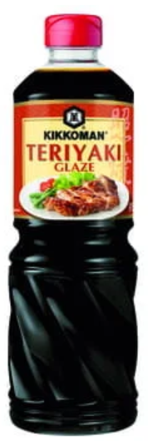

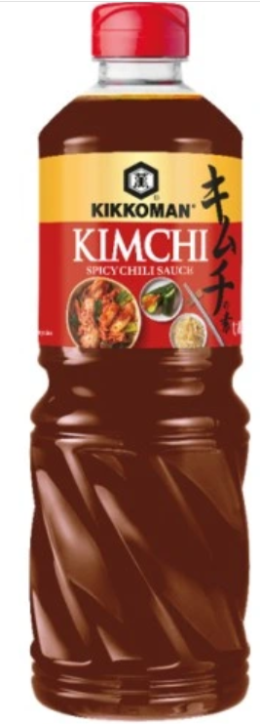
Food service: yearly recipes plan 2026-27
superfoods
Combination of superfoods with umami and Kikkoman sauces
Forest, river & meadow
Creative recipes with ingredients from the nature
Mushrooms reloaded
Autumn season with mushrooms in focus with fusion touch
south east asian
inspiration
Mix of creative Asian ideas
MARCH
JUNE
SEPTEMBER
DECEMBER
PRODUCTS PROMOTED IN THE RECIPES

Slide 29
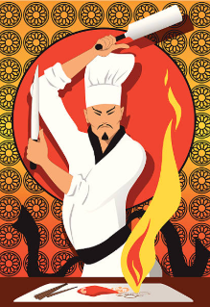

Food service brochure: asian expert
15 RECIPES for Asian flavors
LAUNCH OF RECIPES: January 2026
LAUNCH OF BROCHURE: May 2026
PRODUCTS PROMOTED IN THE RECIPES: full range
How to create easy menus with most actual Asian trends

Slide 30
WHAT's NEW? MATERIALS & TOOLS
3

Slide 31

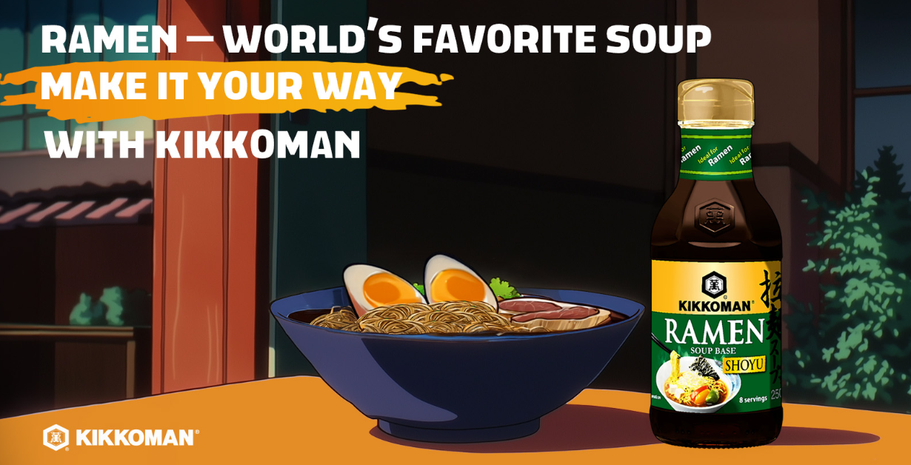
SOCIAL MEDIA CAMPAIGN PACKAGES: YUZU & RAMEN
available in Canto!
Animation video 15s
Key Visual
Social Media assets
Open files available
Ready to use in EN or to adjust for local needs

Slide 32


Slide 33
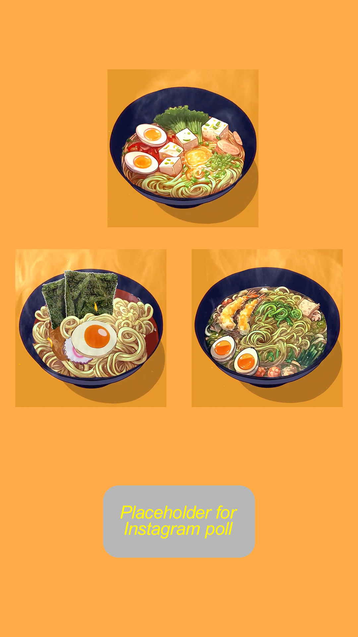

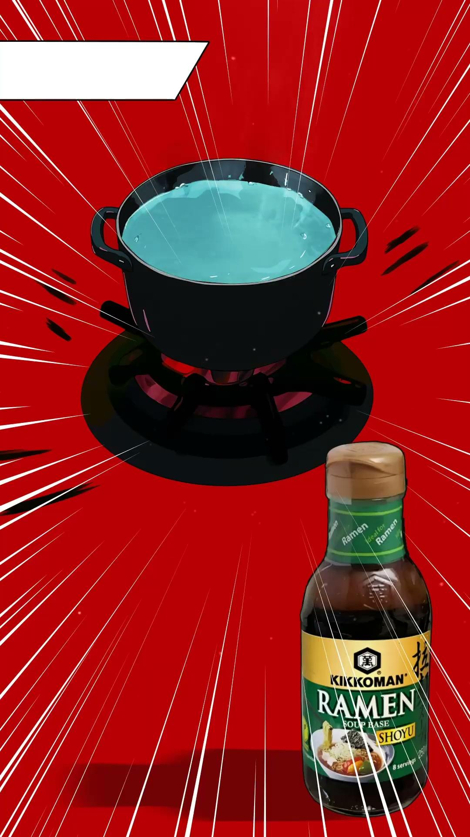

SOCIAL MEDIA CAMPAIGN PACKAGES: YUZU & RAMEN

Slide 34
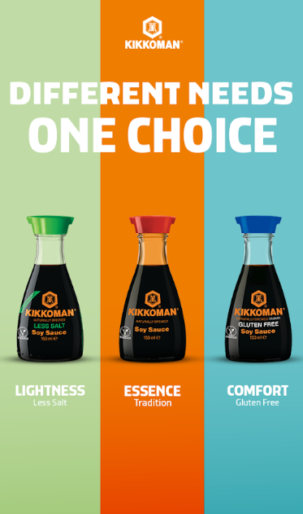
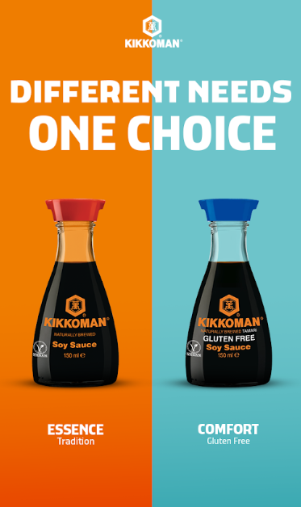
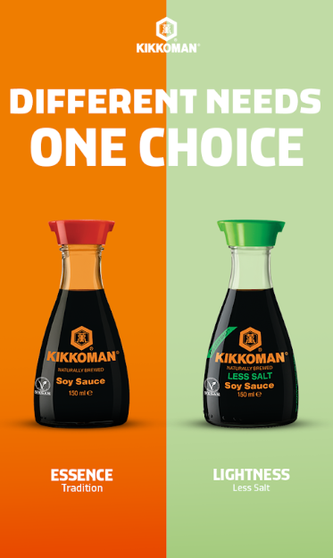
SOCIAL MEDIA CAMPAIGN PACKAGES: 3 SOY SAUCES
available in Canto!

Slide 35
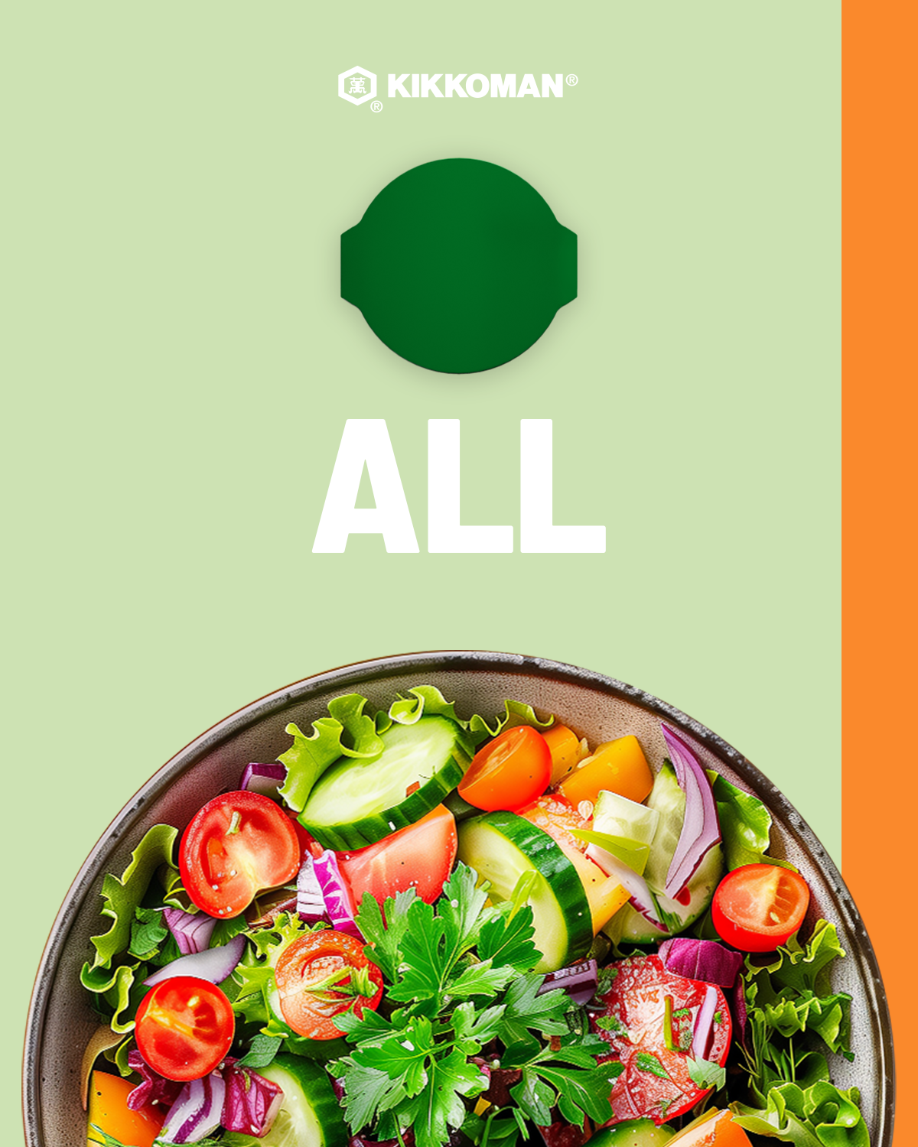
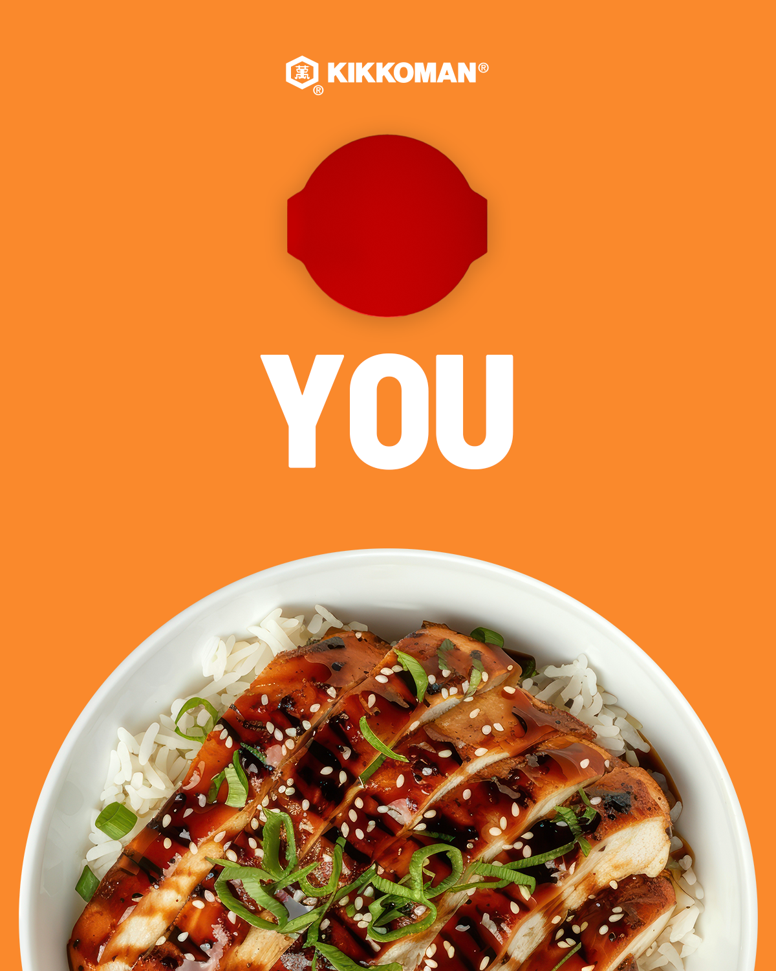
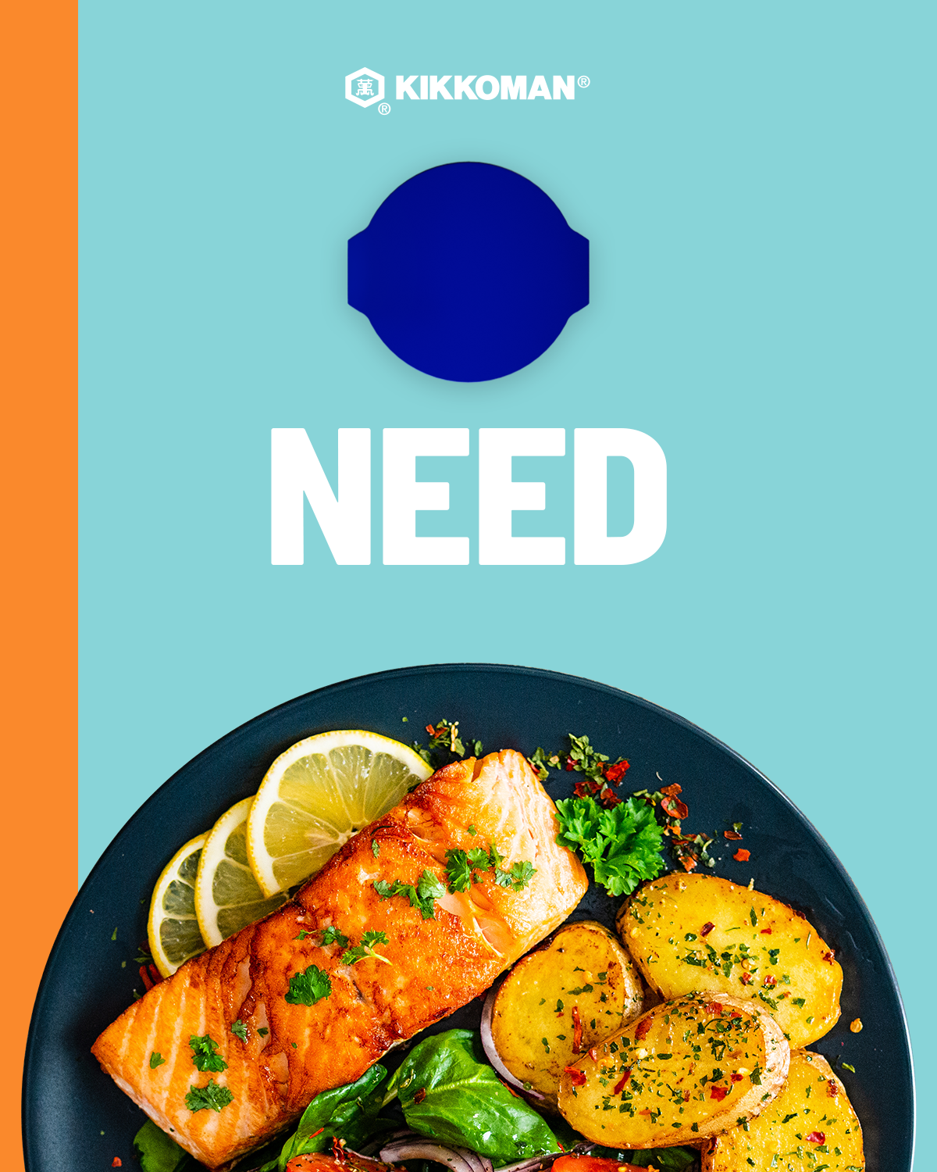
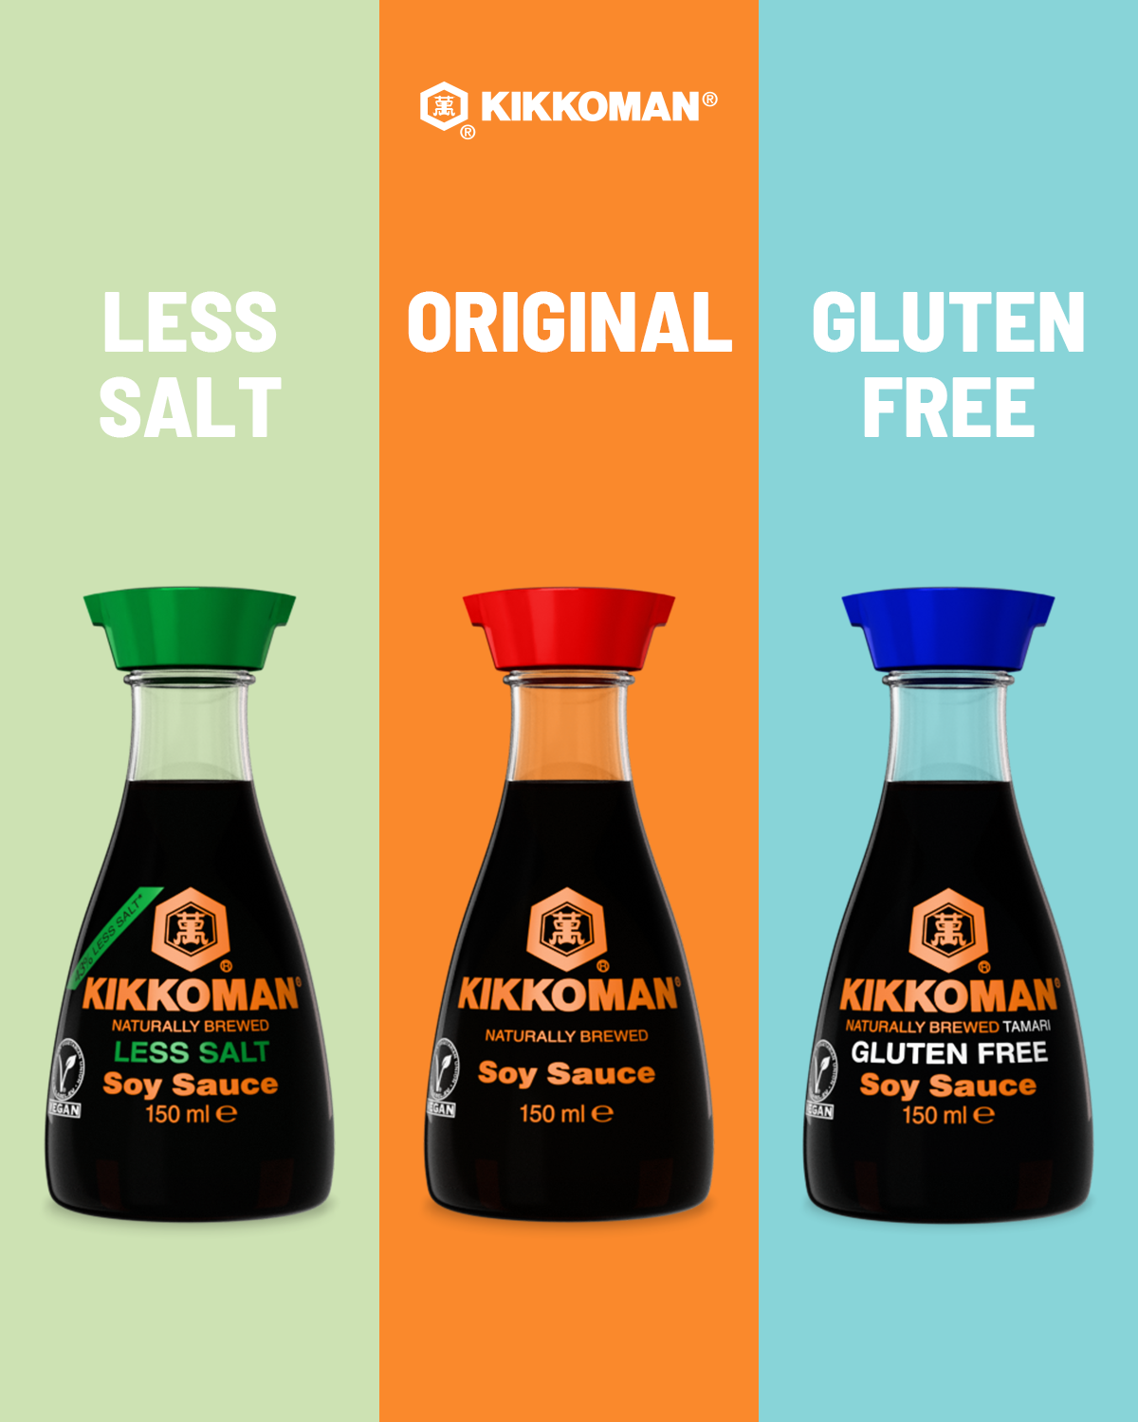
SOCIAL MEDIA CAMPAIGN PACKAGES: 3 SOY SAUCES

Slide 36
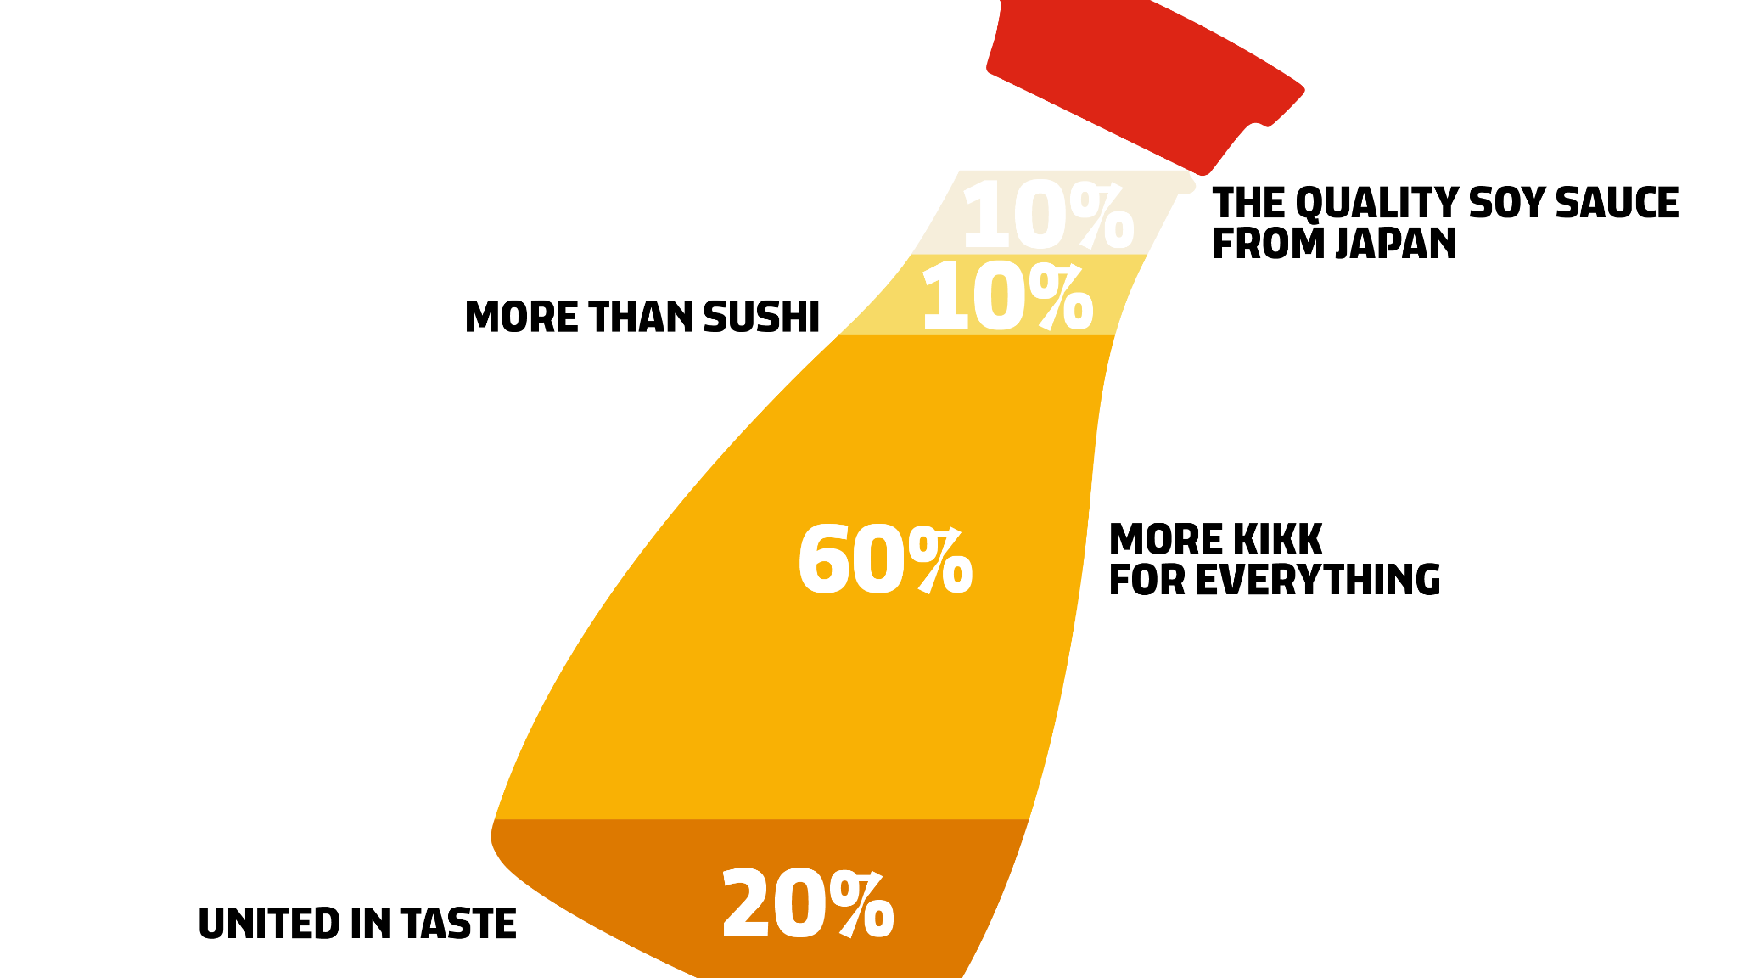
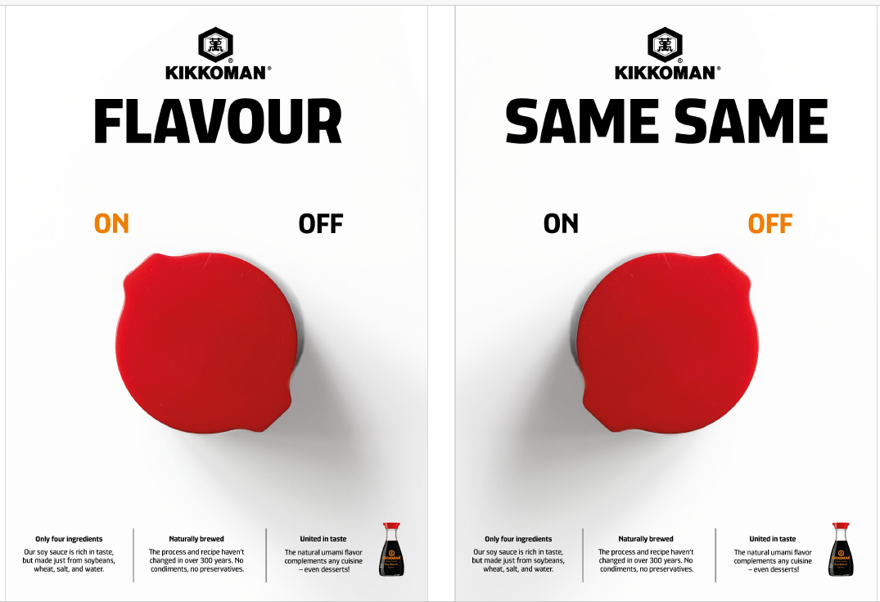
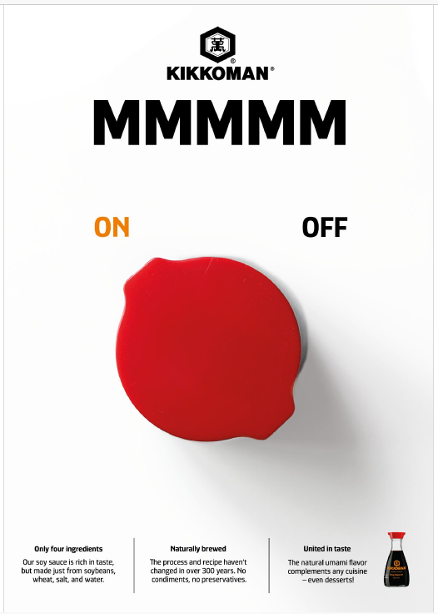
AdS FOR CONSUMERS: on-OFF concept
available in Canto!

Slide 37
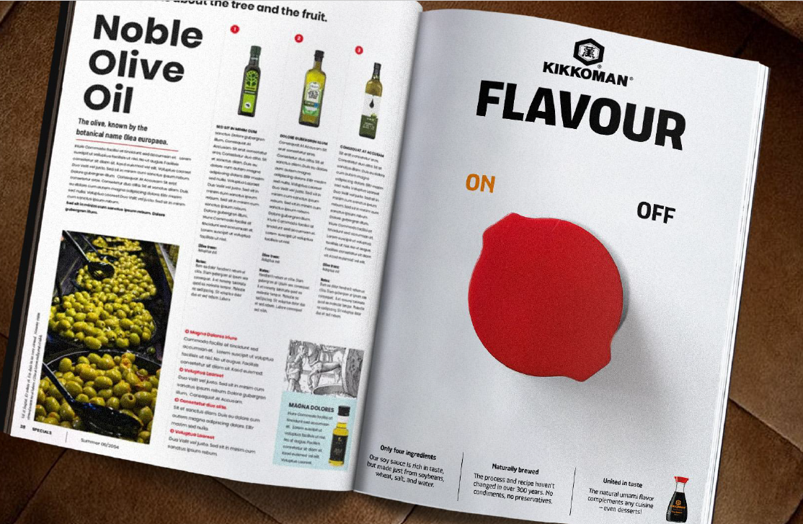
AdS FOR CONSUMERS: on-OFF concept

Slide 38
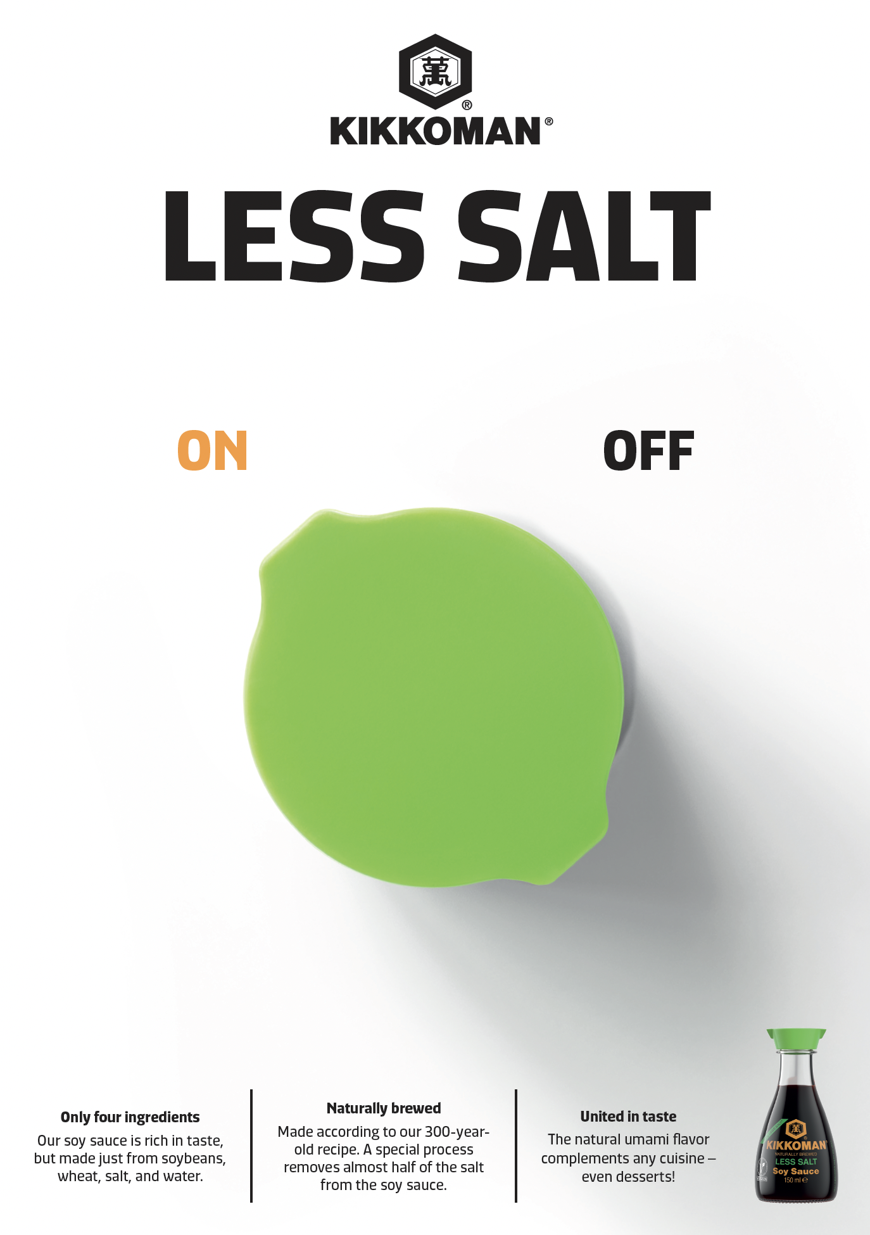

AdS FOR CONSUMERS: on-OFF concept
available in Canto!

Slide 39


AdS FOR CONSUMERS: real fans concept

Slide 40
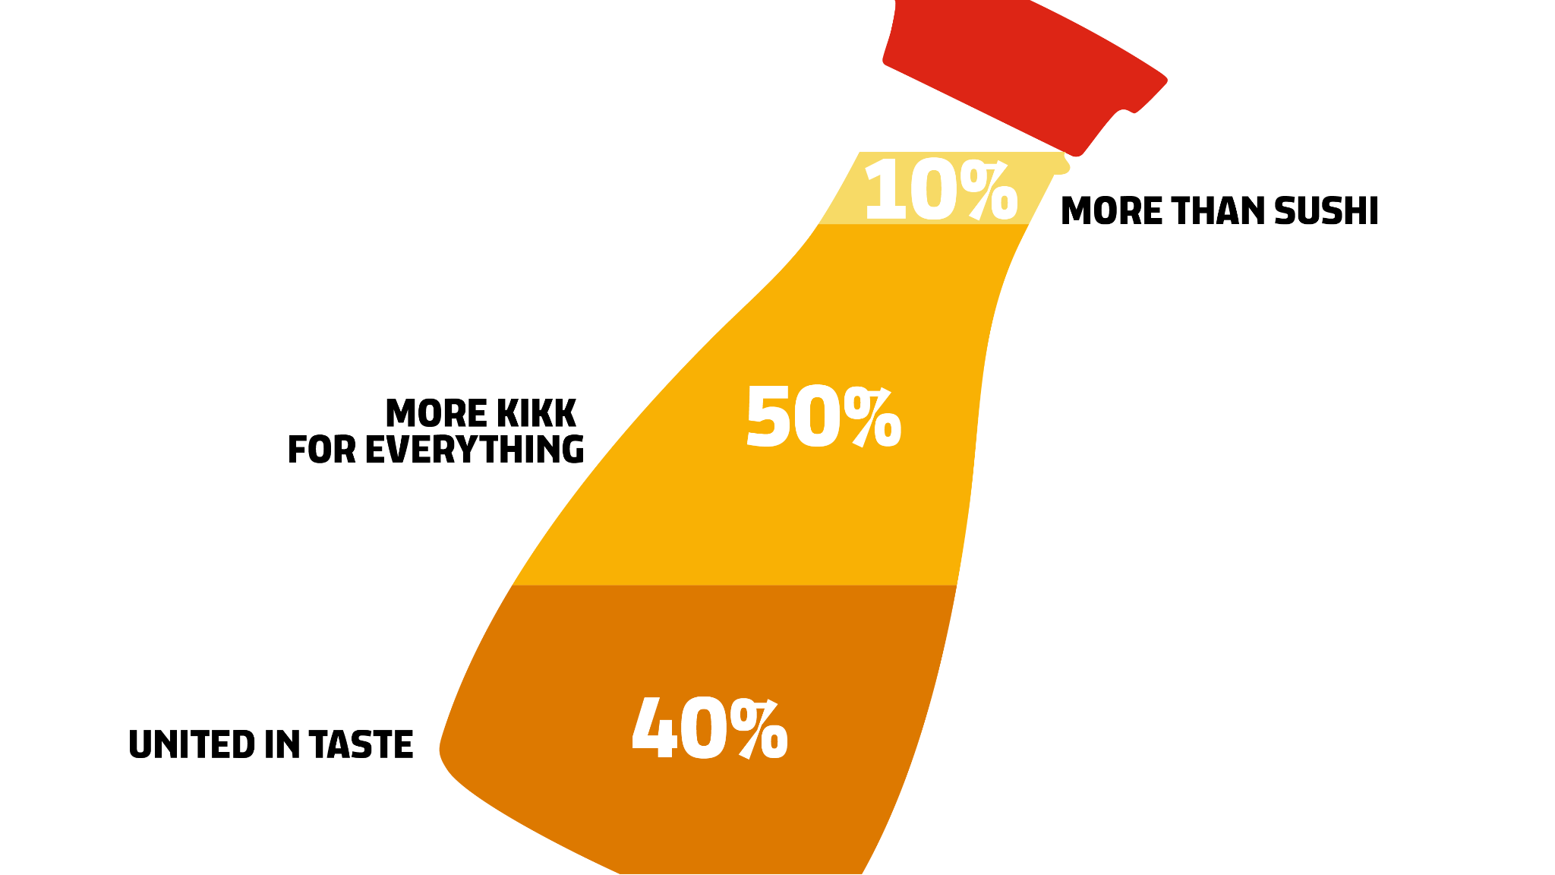
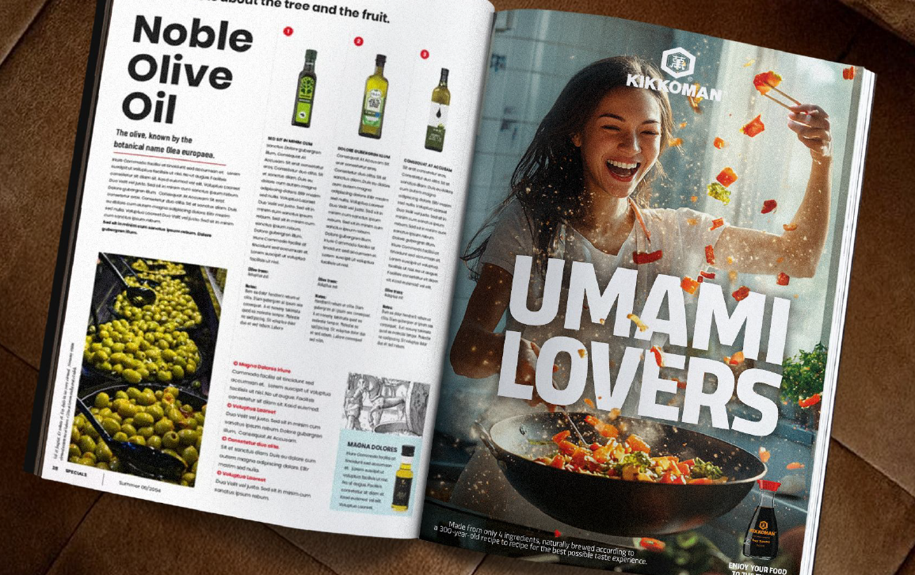
AdS FOR CONSUMERS: real fans concept
available in Canto!

Slide 41
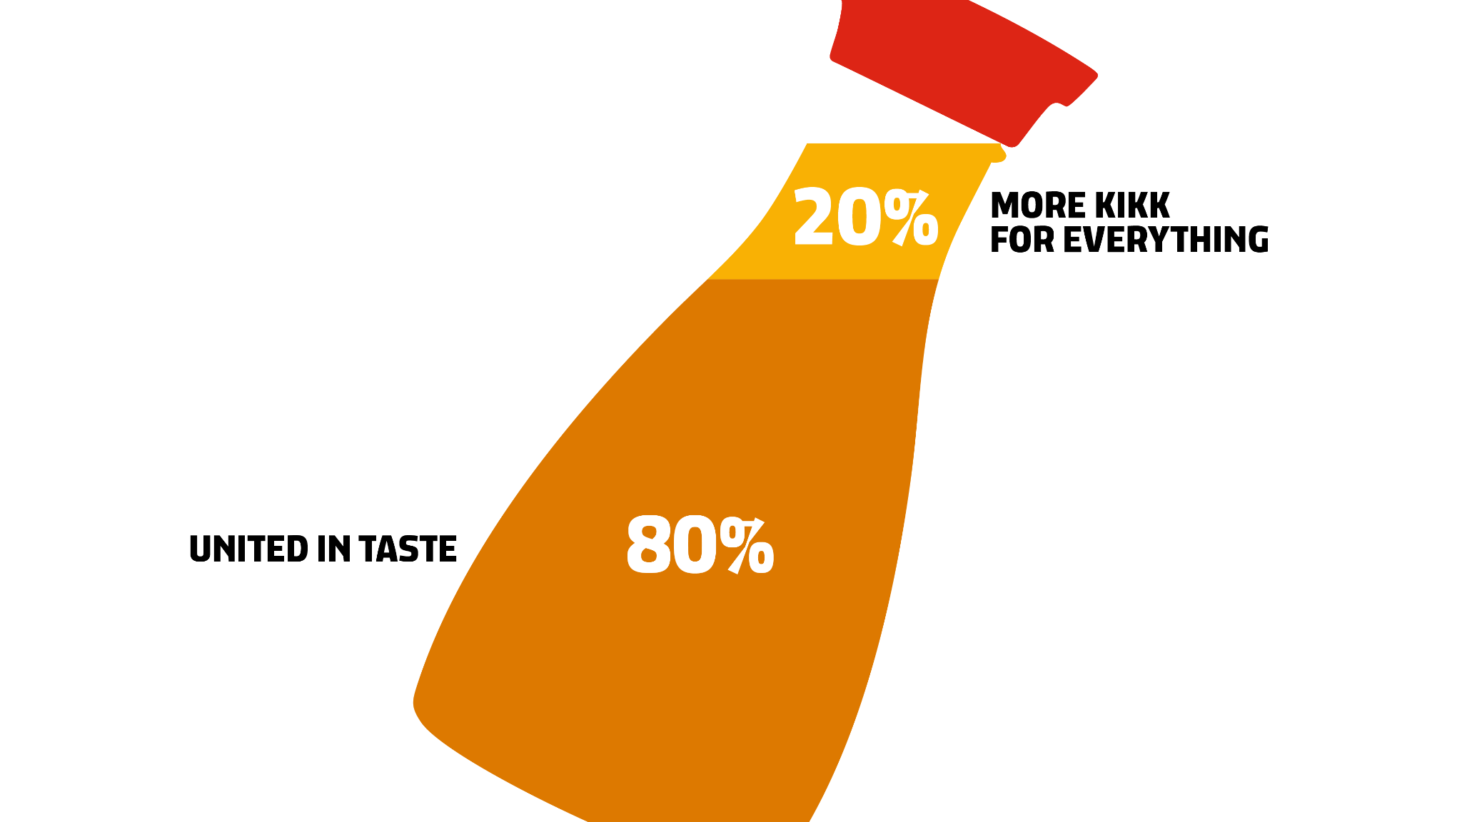
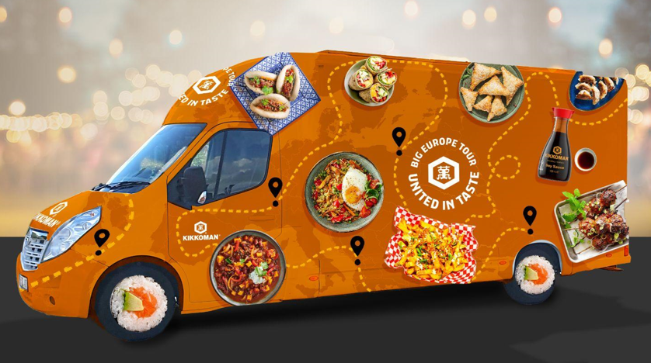
KIKKOMAN FOOD TRUCK 2026
GOAL
Promotion of Kikkoman products along with exchange of international flavors, increase of brand visibility offline across Europe
FOCUS
United in taste: mix of foods, places & cultures
MATERIAL
Branded Food Truck & social media coverage
START
April 2026
DURATION
All fiscal year 2026/2027
BUDGET
Local costs: km, driver and event costs
COUNTRIES INCLUDED: all European countries!

Slide 42
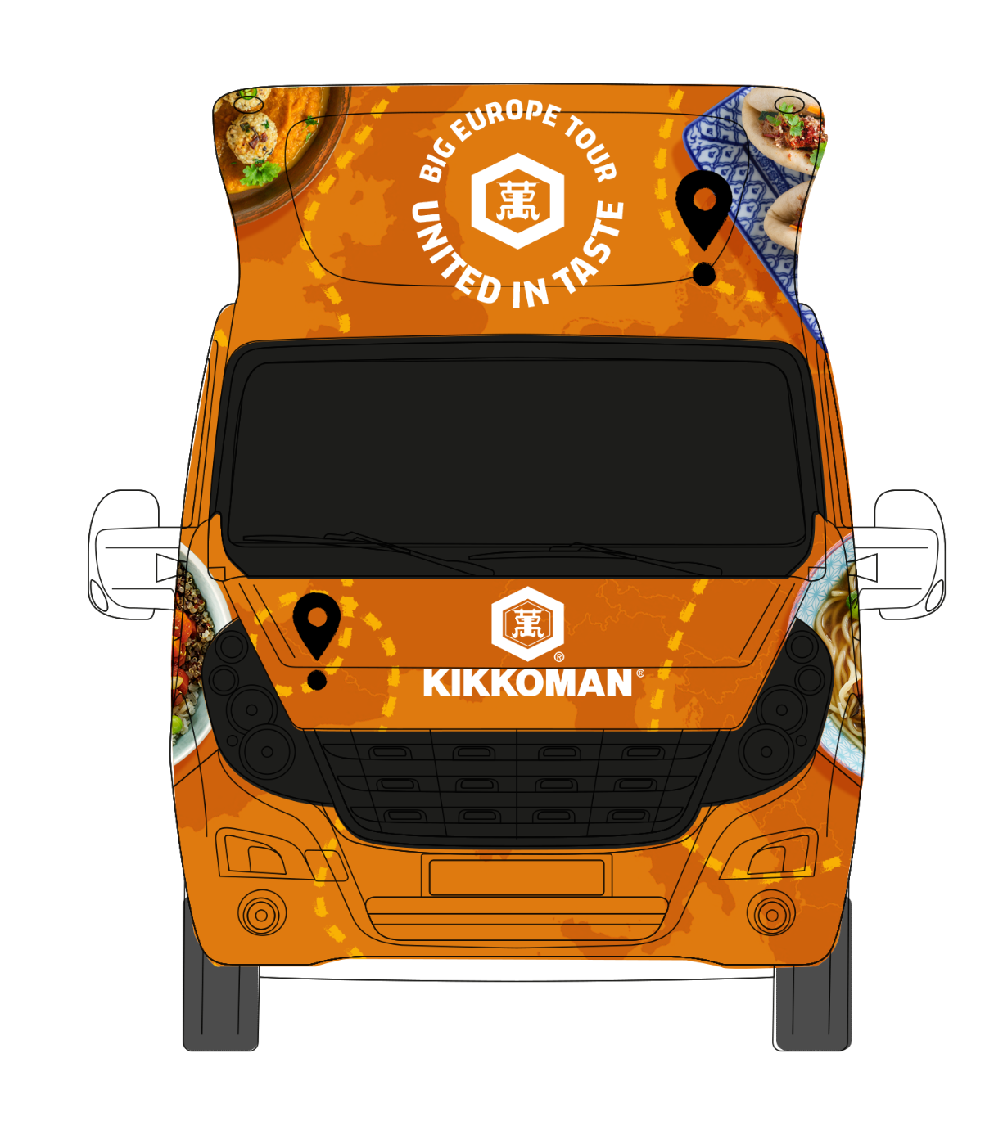
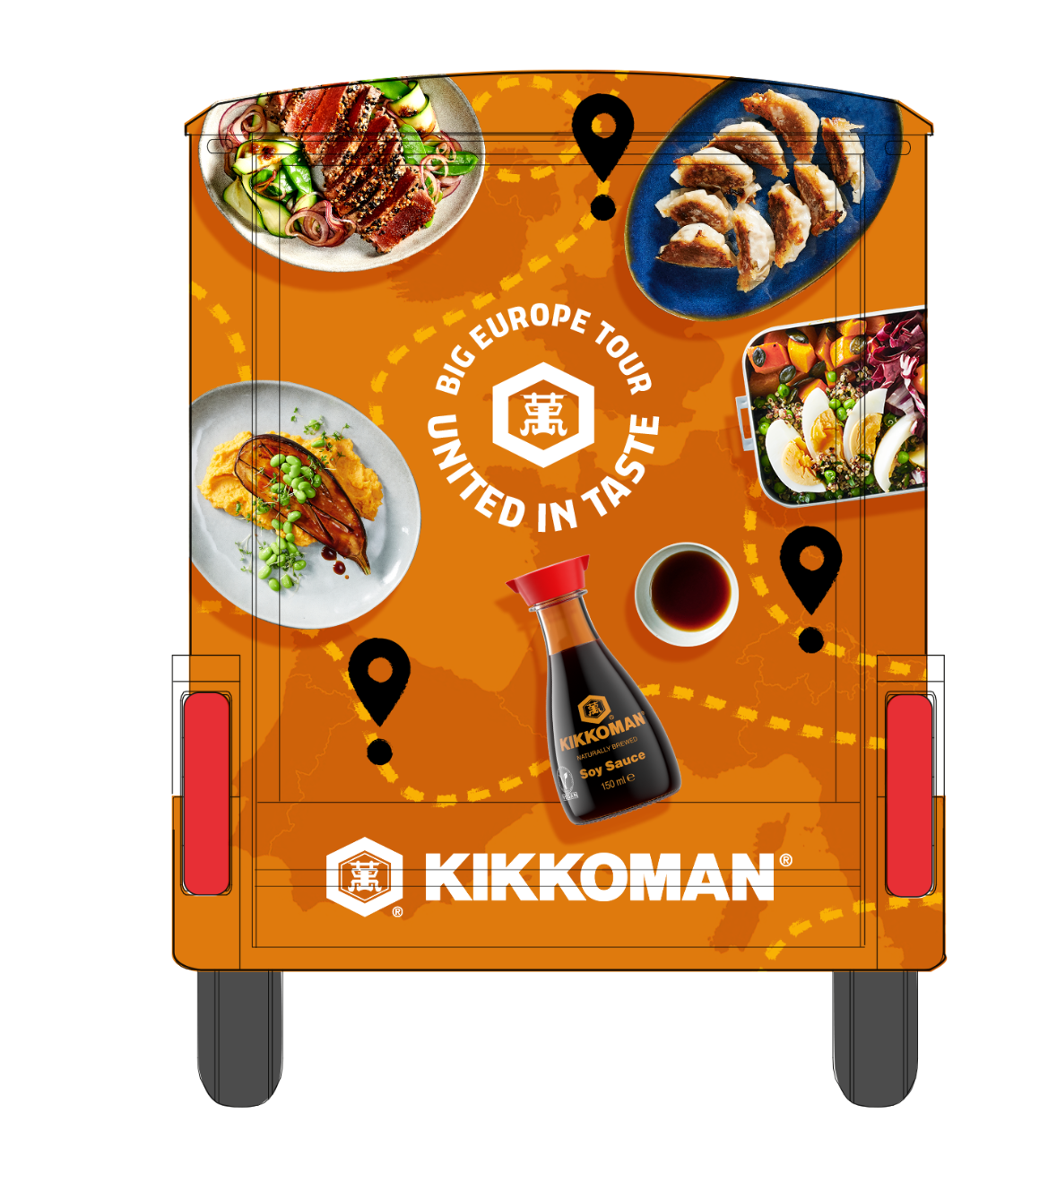
KIKKOMAN FOOD TRUCK 2026

Slide 43
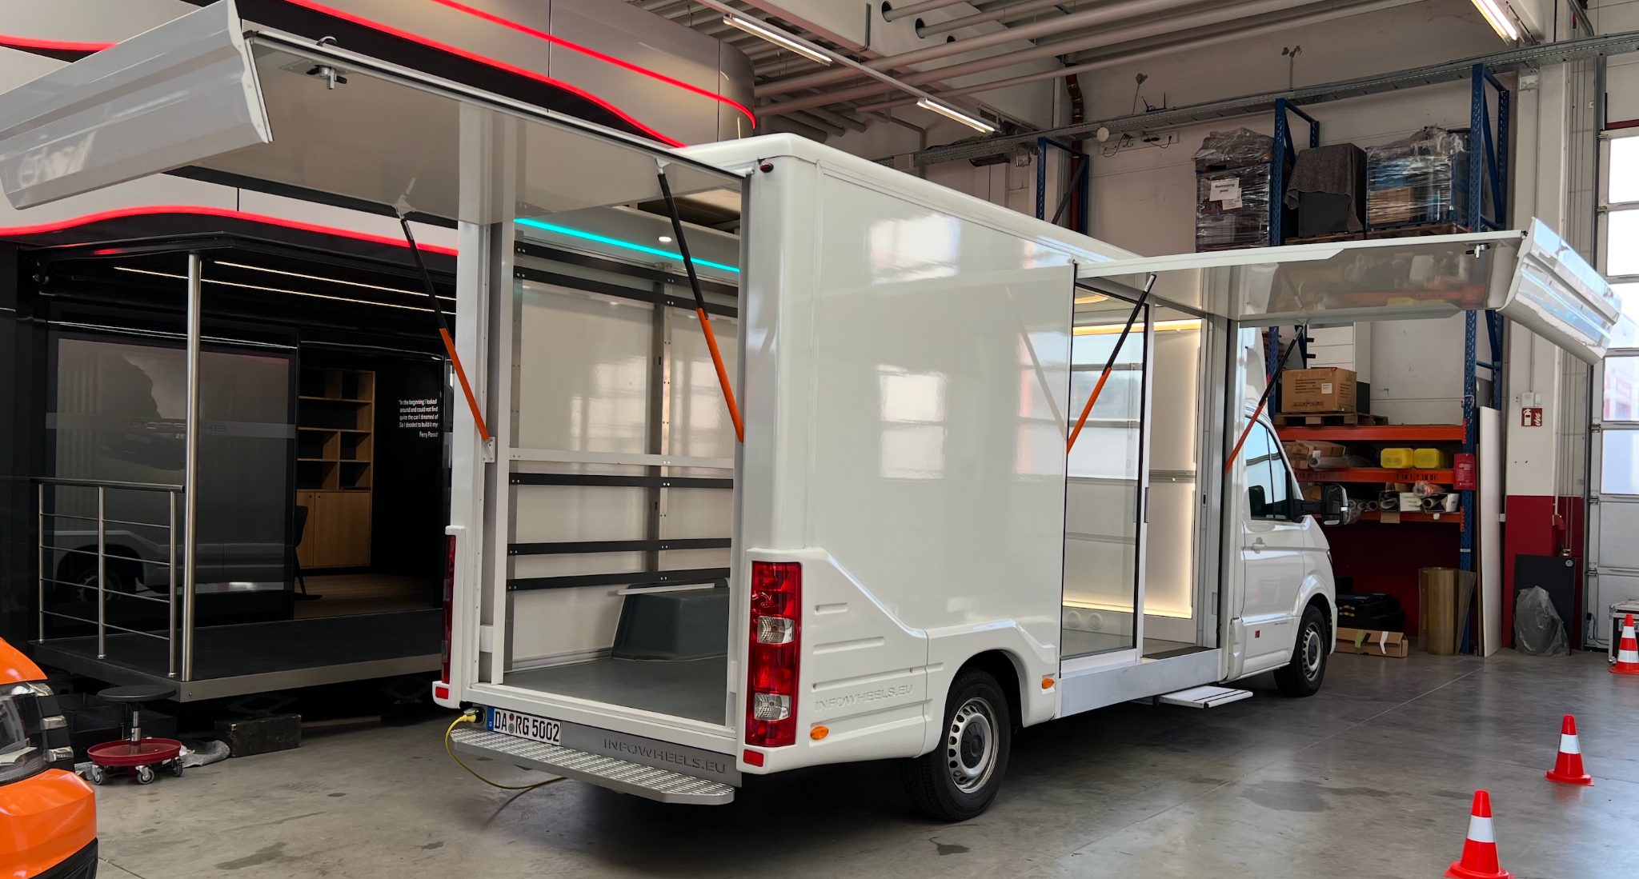
KIKKOMAN FOOD TRUCK 2026
GOAL
FOCUS
MATERIAL
TV screen
START
DURATION
BUDGET

Slide 44
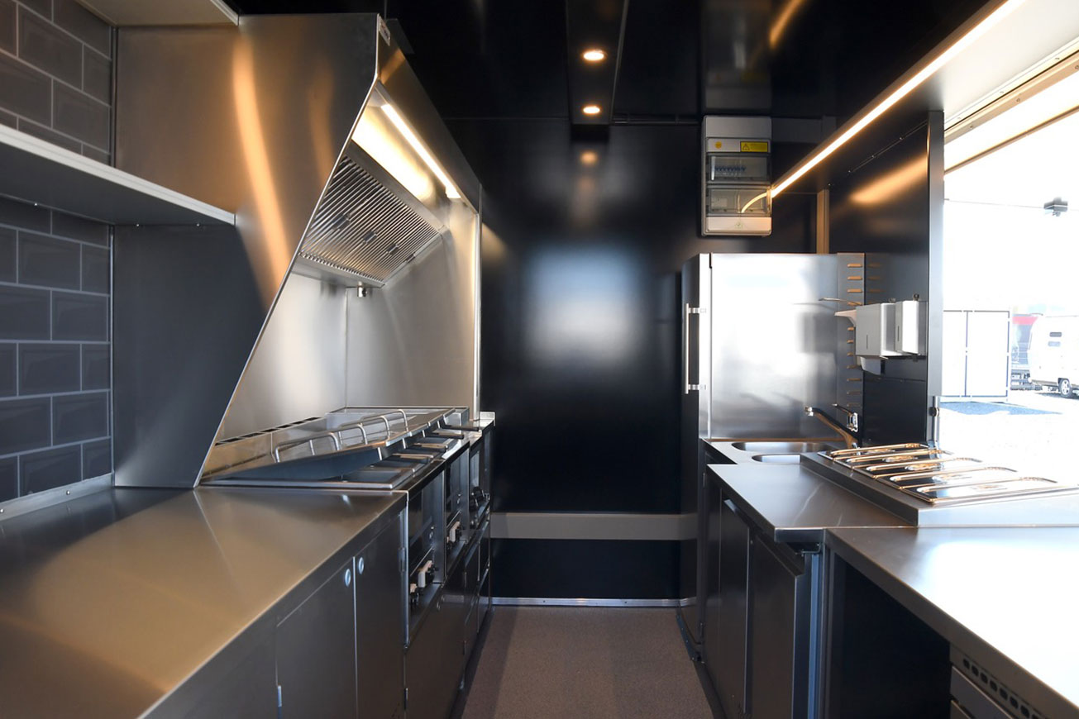
KIKKOMAN FOOD TRUCK 2026 - equipment
Oven with min. 2 plates
Under-counter refrigerators with drawers
Free-standing refrigerator for larger containers
Freezer
Wardrobe
Salamander sandwich maker
Grill plate with two thermostats
Professional deep fryer
Burger press
Worktops above under-counter refrigerators
A sink with water and a hot water boiler
Glass display cabinet
Container for napkins and cutlery
Magnetic strip for knives
Good extractor bonnet with powerful motor
Walls made of stainless steel

Slide 45
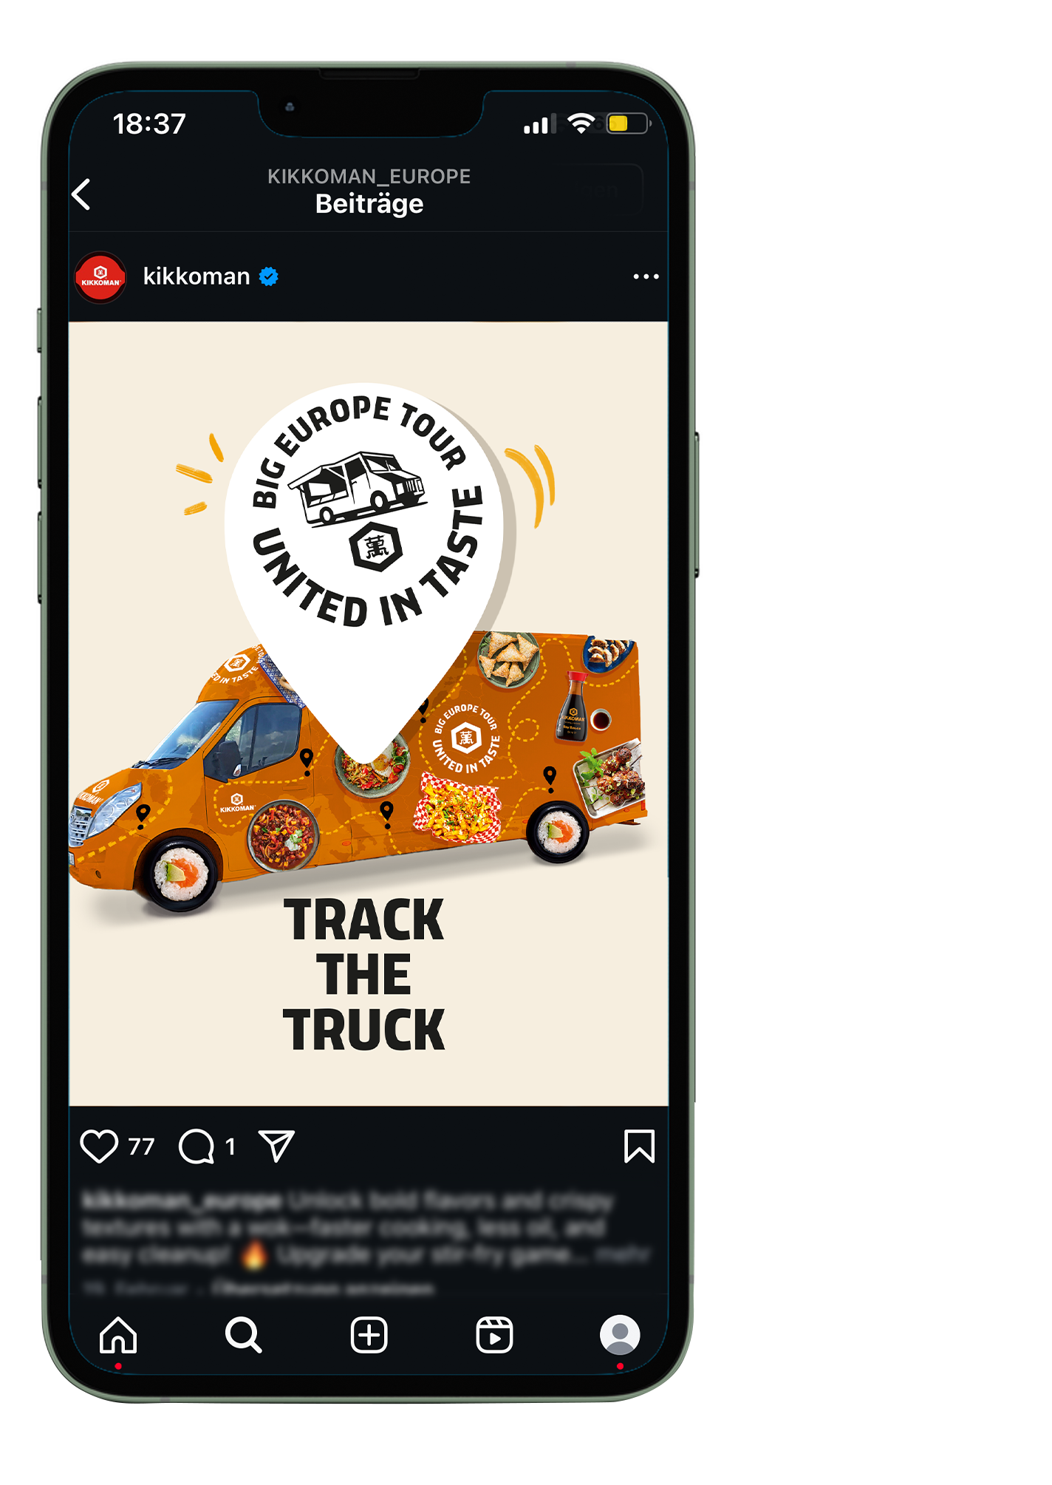
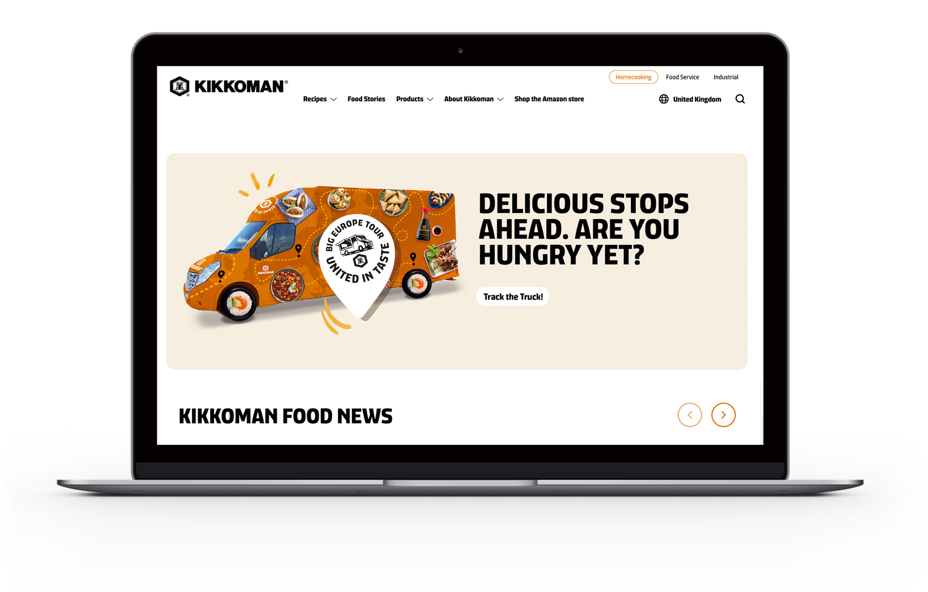
KIKKOMAN FOOD TRUCK 2026
SOCIAL MEDIA AND WEBSITE PRESENCE - WORK IN PROGRESS

Slide 46
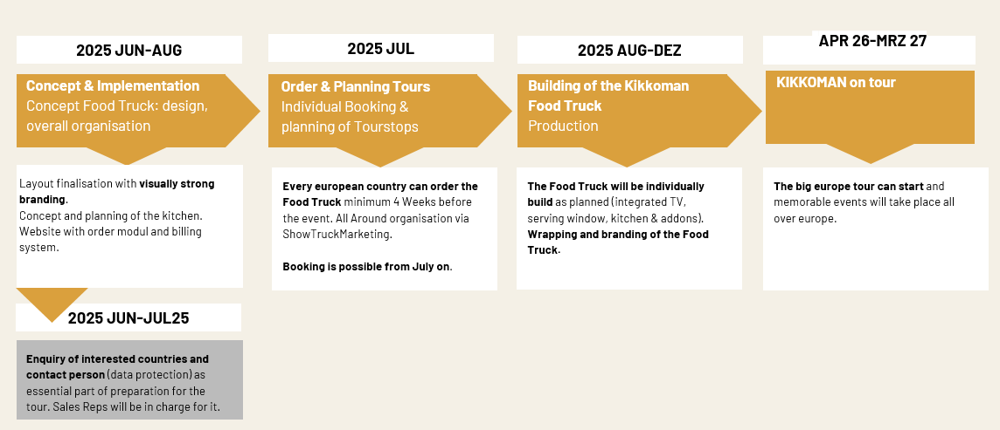
KIKKOMAN FOOD TRUCK 2026
TIMING & PROCESS

